Slide 1
Secure IoT Communication with ECC-based e2e Encryption
Supervised by
Dr. Kasuni Welihinda

Slide 2
ABOUT ME
Name: Isuru Amarathunga
UoW ID: W1956340
IIT ID: 20220831
MSc Cyber Security & Forensics
University of Westminster

Slide 3
01
04
Algorithm Analysis
Problem Background
02
05
Research Gap
Demo of the Prototype
03
06
Proposed solution
Future Improvements

Slide 4
01
Problem Background

Slide 5
01 Problem Background
Problem Background
Resource constrained devices becoming the backbone of the several applications, from smart homes, wearable gadgets to many other electronic sensors.
Common fact of any of these devices are their limited processing power, memory and energy consumption which limit their capabilities.
limited computational resource on these devices has a challenge on applying security mechanisms which uncover devices to the emerging cybersecurity threats

Slide 6
01 Problem Background Cont..
Problem Domain
MQTT (Message Queuing Telemetry Transport), a network protocol employs on several IoT devices due to its lightweight nature and ability to perform well on resource-constrained devices, even under limited network bandwidth.
Inadequate security implementation might decrease the efficiency of the communication and lack of security implementation make device vulnerable to interception, tampering or unauthorized access.
There is an increasing demand for the proper security implementation of MQTT protocol as it does not have in-build encryption mechanism. Not all cryptographic algorithms suit to encrypt MQTT communication as it is on resource constrained devices hence proper implementation of the encryption algorithm requires to safeguard data transmitted between IoT devices.

Slide 7
02
Research Gap

Slide 8
02 Research Gap
Significant research gap exists on implementation of the robust encryption mechanism in IoT communication as IoT devices lack of computational power.
Many IoT devices have widely adopted MQTT due its lightweight capabilities but lack of native supports on communication encryption open doors for the developers to bring own encryption mechanism which addresses specific set of problems and domain.
ECC encryption is a wide area as it heavily adopted on many cryptosystems but tailored one for resource constrained devices and also rotate encryption key is another challenge.
Research cannot be bounded to the implementation of a secured algorithm but evaluation of the algorithm by measuring resource utilization, latency and throughput.

Slide 9
03
Proposed Solution

Slide 10
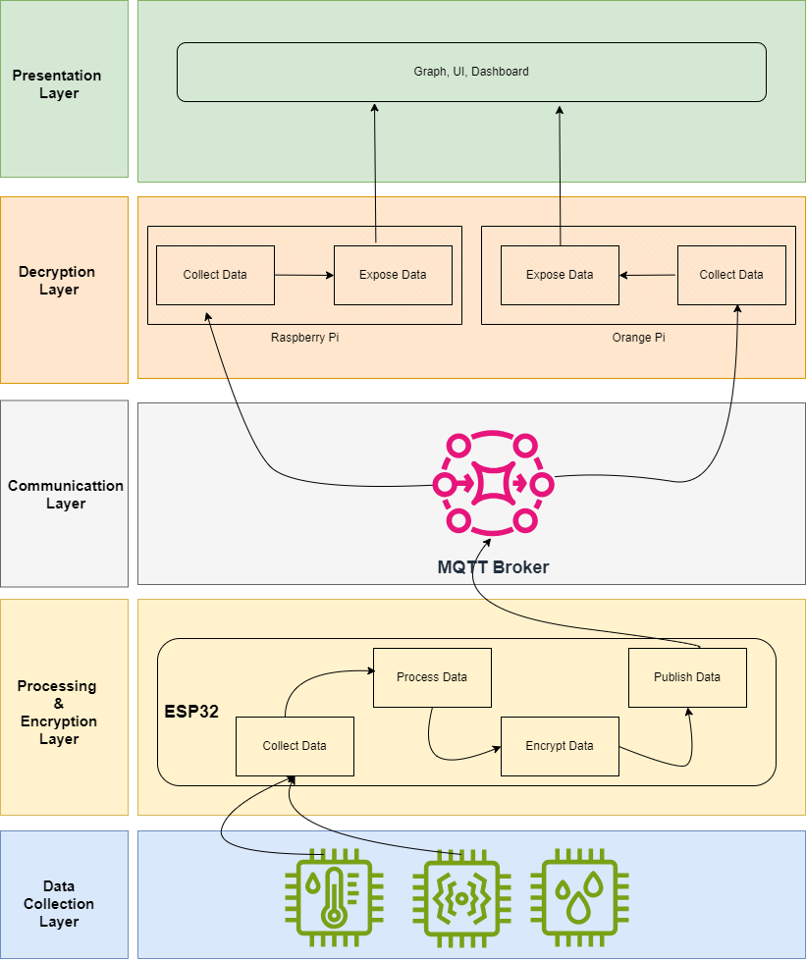
03 Proposed Solution
Aim
This research aims at design, developing, evaluation and successful implementation of a E2E encryption with ECC based algorithm to secure MQTT communication.

Slide 11
04
Algorithm Analysis
5%
50%
40%

Slide 12
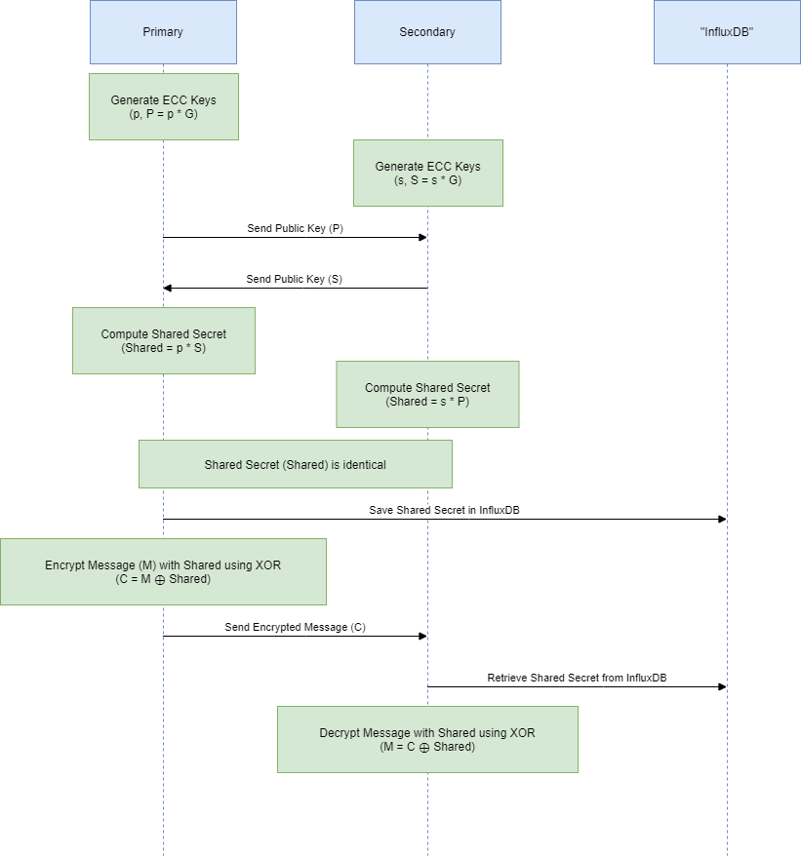
04 Algorithm Analysis
Encryption processes consists of two major component as key pair generation and shared secret calculation. To generate the key pair in Python, “tinyec” package and “brainpoolP256r1” is used.

Slide 13
05
Demo of the Prototype

Slide 14
06
Future Improvements

Slide 15
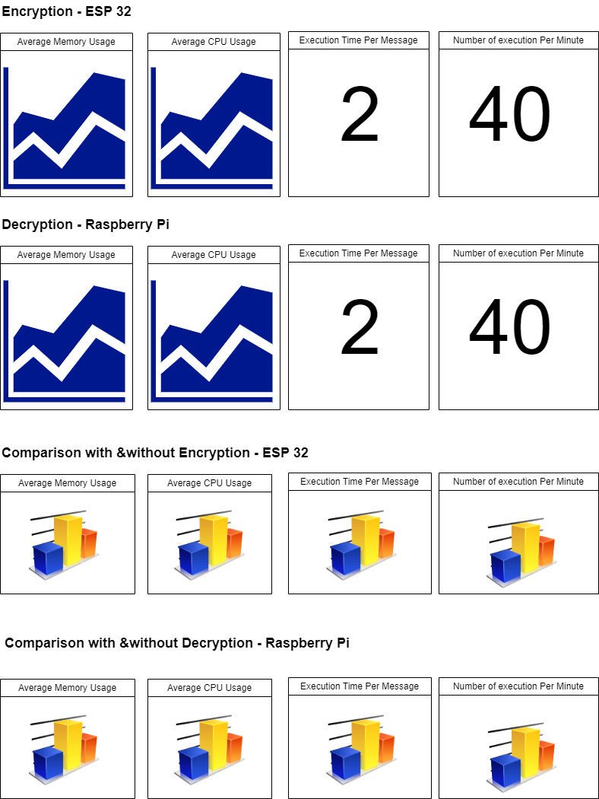
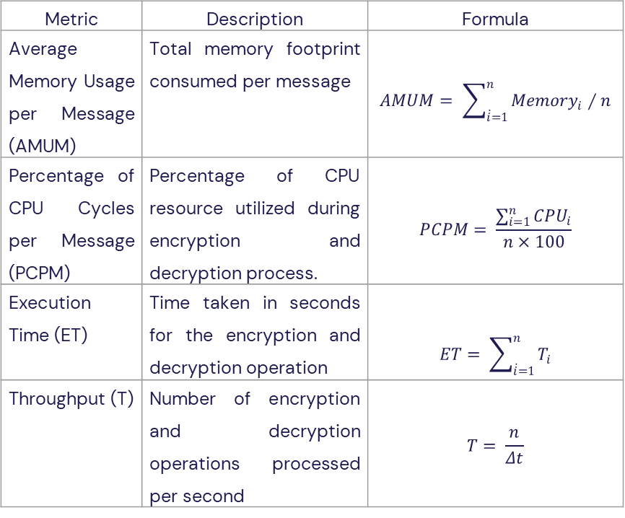
06 Future Improvements
Metric | Description | Formula
Average Memory Usage per Message (AMUM) | Total memory footprint consumed per message | $$AMUM= \sum_{\dot{i}=1}^{n}{{Memory}_{i}}∕n$$
Percentage of CPU Cycles per Message (PCPM) | Percentage of CPU resource utilized during encryption and decryption process. | $$PCPM= \frac{\sum_{i=1}^{n}{{CPU}_{i}}}{n×100}$$
Execution Time (ET) | Time taken in seconds for the encryption and decryption operation | $$ET= \sum_{\dot{i}=1}^{n}{T_{i}}$$
Throughput (T) | Number of encryption and decryption operations processed per second | $$T= \frac{n}{Δt}$$

Slide 16
THANK YOU !!!

